Slide 1
NAME : JAISHREE R REG NO. : 730321104015 NM ID : au730321104015 DEGREE : B.E - CSE YEAR : III COLLEGE NAME : BUILDERS ENGINEERING COLLEGE
3/21/2024 Annual Review

Slide 2
PROJECT TITLE
CNN-BASED CIFAR-10 CLASSIFIER​
3/21/2024 Annual Review

Slide 3


AGENDA
PROBLEM STATEMENT​
PROJECT OVERVIEW​
WHO ARE THE END USERS?​
SOLUTION AND ITS VALUE PROPOSITION​
THE WOW IN YOUR SOLUTION​
MODELLING​
RESULTS​
3/21/2024 Annual Review

Slide 4

PROBLEM STATEMENT
The CIFAR-10 dataset has 60,000 small color images sorted into 10 groups. The task is to create a Convolutional Neural Network that correctly identifies these images during testing.
3/21/2024 Annual Review

Slide 5

PROJECT OVERVIEW
CIFAR-10 DATASET
DATA PREPROCESSING
CNN-ARCHITECTURE
TRAINING
OPTIMIZATION
3/21/2024 Annual Review

Slide 6

WHO ARE THE END USERS?
Researchers and Practitioners in Computer Vision
Data Scientists and Machine Learning Engineers
Educators and Students
Developers and Engineers
General Public
3/21/2024 Annual Review

Slide 7

YOUR SOLUTION AND ITS VALUE PROPOSITION
SOLUTION:
This solution outlines the step-by-step process for building, training, evaluating, and deploying a CNN-based CIFAR-10 Classifier, emphasizing data preprocessing, model architecture design, training optimization, deployment considerations, and documentation requirements.
VALUE PROPOSITION:
High Accuracy and Reliability
Efficiency and Scalability
Flexibility and Customization
Educational Resource
Time and Cost Savings
Continuous Improvement
3/21/2024 Annual Review

Slide 8

THE WOW IN YOUR SOLUTION
The "wow" factor in the CNN-based CIFAR-10 Classifier solution lies in its ability to seamlessly combine cutting-edge deep learning techniques with practical applications, resulting in a powerful tool with significant value for users.
Exceptional Accuracy
Efficiency and Scalability
Educational Value
Practical Applications
Time and Cost Savings
Decision Support and Insights
3/21/2024 Annual Review

Slide 9
MODELLING
Teams cam add wireframes
Define Model Architecture
Convolutional Layers
Pooling Layers
Flattening
Fully Connected Layers
Regularization Techniques
Model Compilation
Model Summary
Visualization
Model Training and Evaluation
Fine-Tuning
3/21/2024 Annual Review

Slide 10
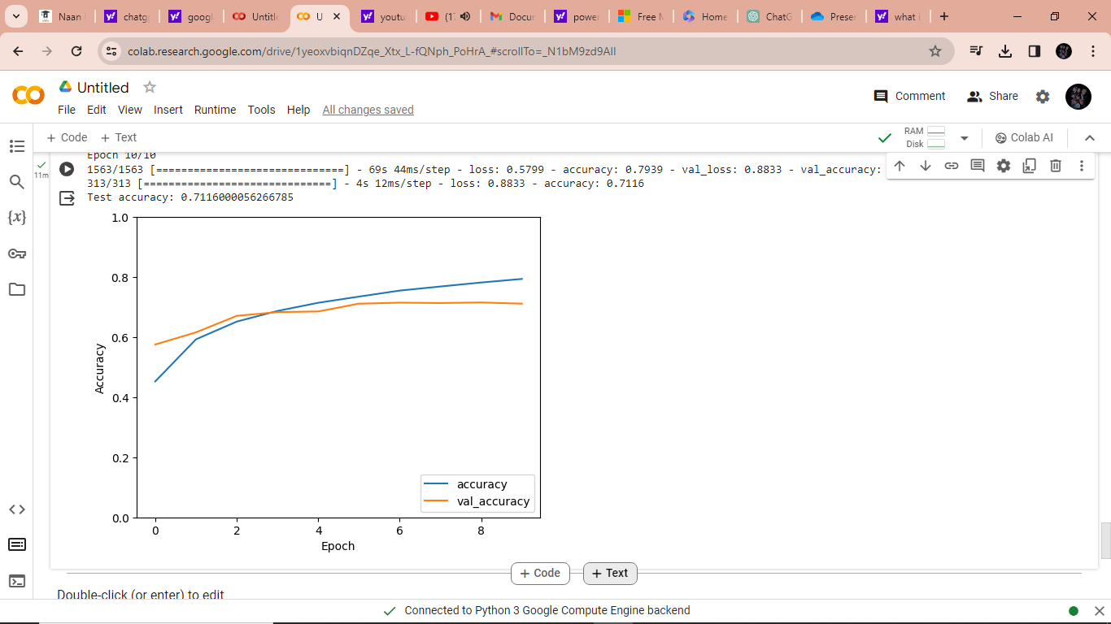
RESULTS

